Slide 1


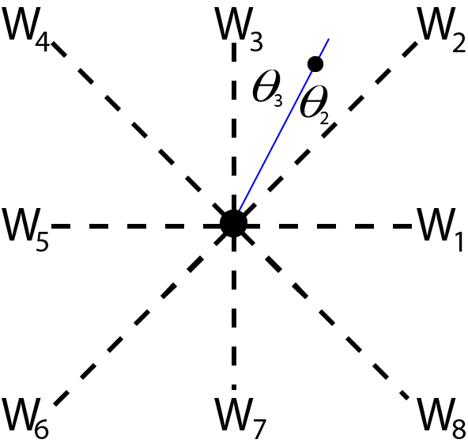
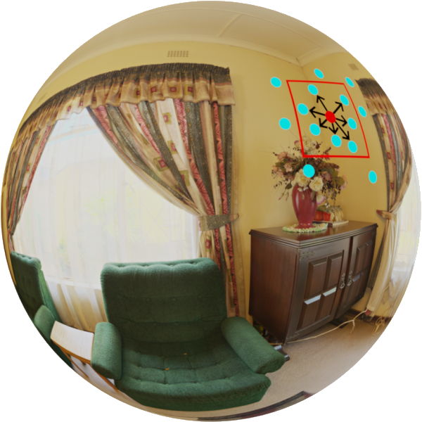
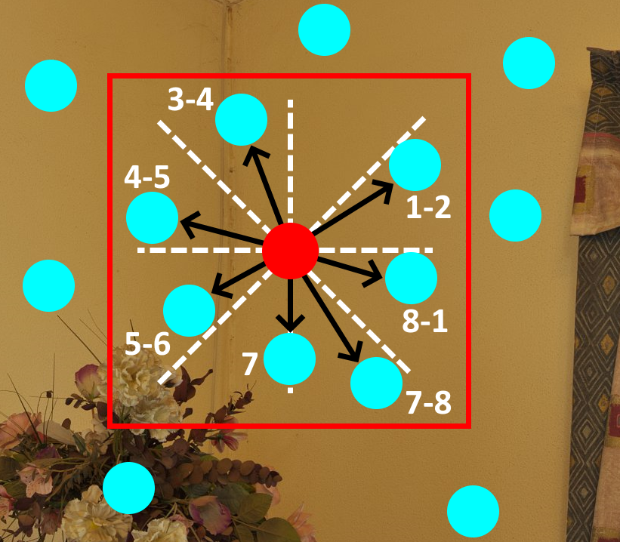
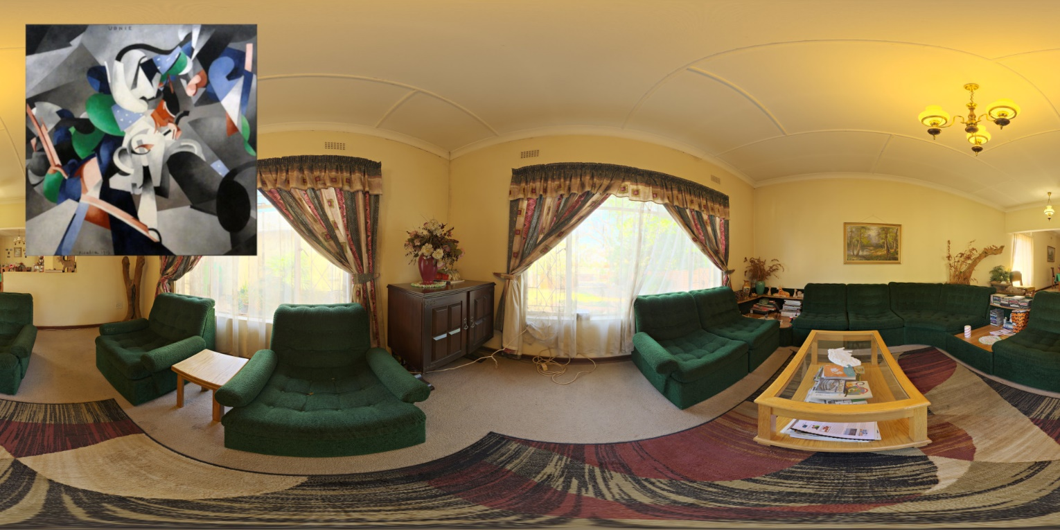
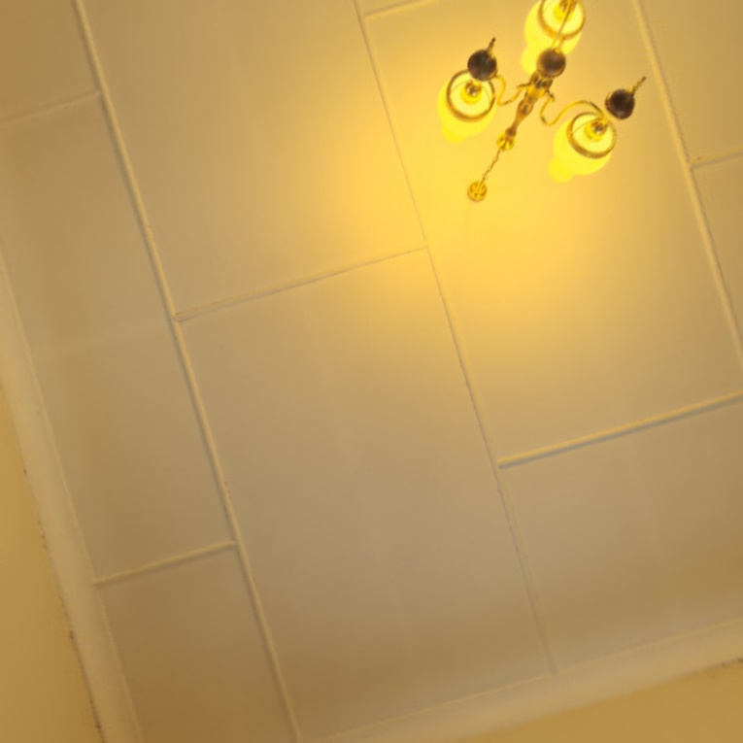
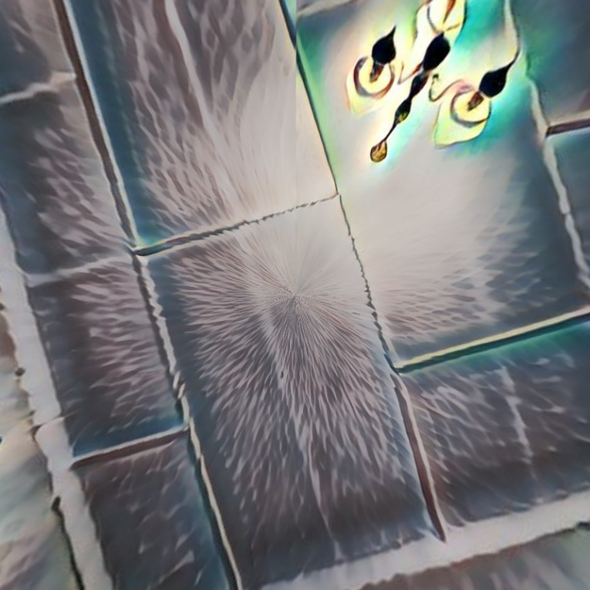
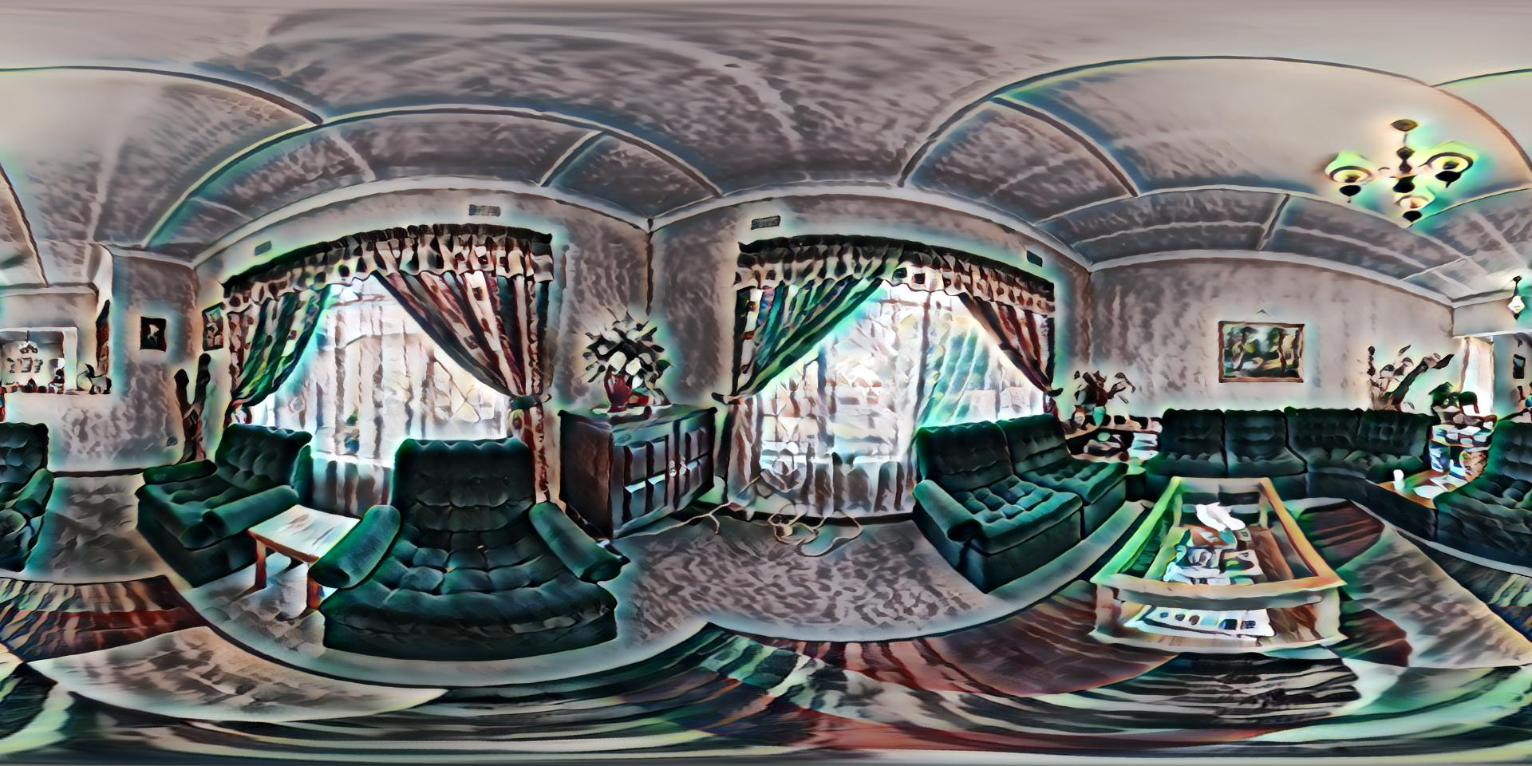
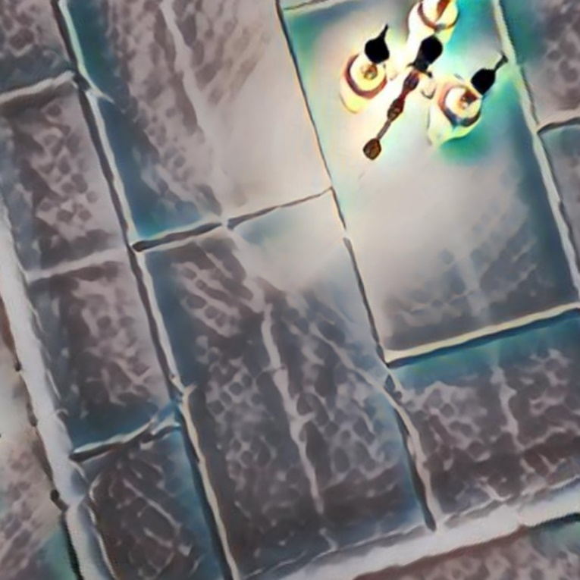
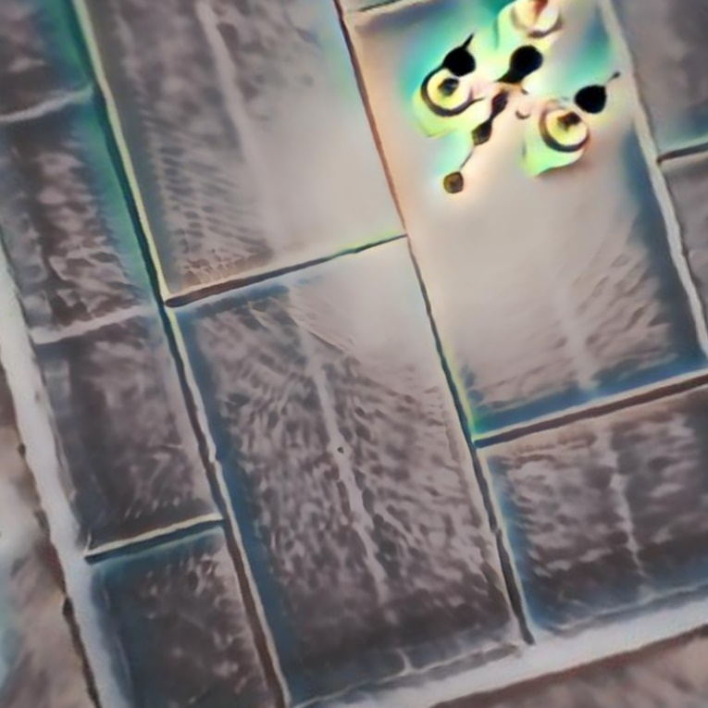
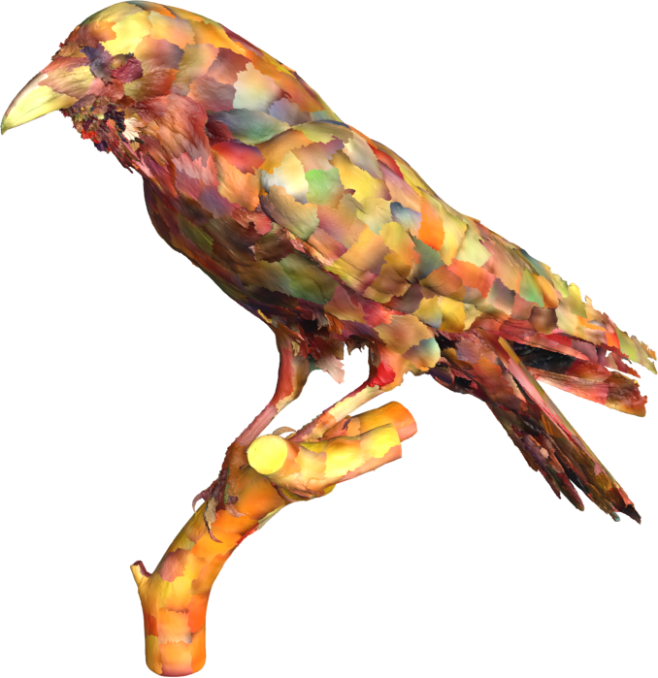
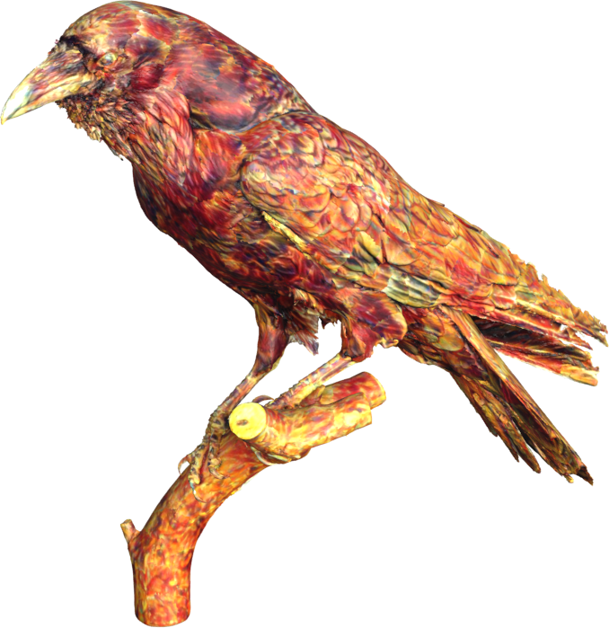
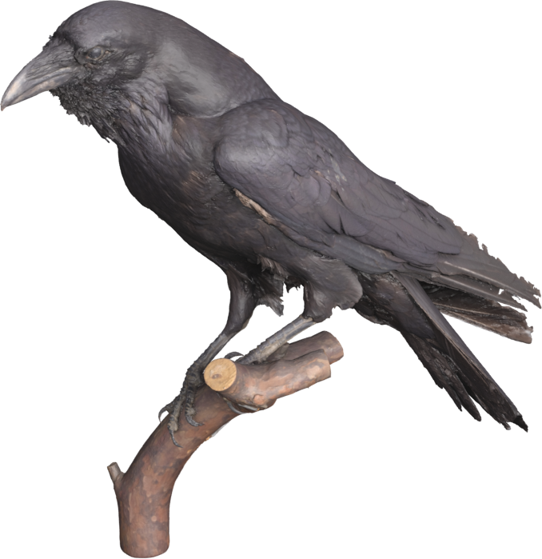
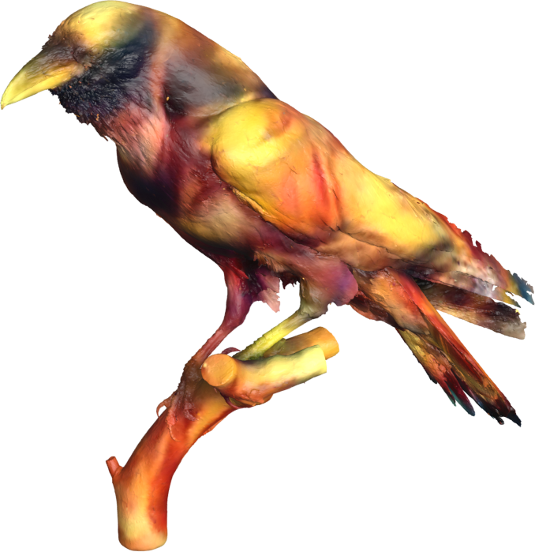
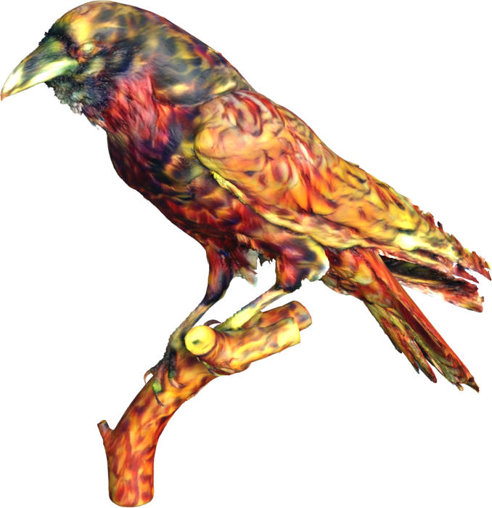

Interpolated SelectionConv
for Spherical Images and Surfaces
David Hart, Michael Whitney, Bryan Morse
Brigham Young University
Motivation
Method
Is there a way to transfer weights from CNNs trained on regular images to irregularly-sampled spheres and surfaces?
In the original SelectionConv work, edges were given the selection of the cardinal or ordinal direction most closely aligned with the spatial relationship between the respective pixels or nodes. With general sampling patterns, however, node relationships do not lie so cleanly along specific axes. Thus, it is beneficial to be able to interpolate between multiple selections. To do this, we assign the same source and target node to multiple adjacency matrices. Then, we assign each of those edges a fractional interpolation value that indicates the spatial relationship of the node relative to neighboring directions.
Key Idea
Building on SelectionConv, we introduce interpolation into the graph, which allows for arbitrary point-cloud structures.
By using interpolated selections, our graph structures can be defined for general point cloud structures, such as those generated from sampling a spherical surface or a 3D mesh. By defining the graph structure in 3D space, and then making selection assignments based on the local planar projection for each individual node, our interpolated SelectionConv can accurately represent oriented convolution on surfaces. This creates one cohesive framework that does not require designing a specific projection for each unique surface. Additionally, just like the original SelectionConv, we can transfer weights from networks trained on 2D images to our system.
Spherical Graph
Local Planar Projection
Application 1: Spherical Images
Additionally, we evaluate our method in performing segmentation using the Stanford 2D-3D-S dataset. It consists of equirectangular images of various indoor scenes with 13 different classes. We compare to various methods designed specifically for spheres. Even after a simple direct transfer, our approach is competitive with the state-of-the-art methods.
Equirectangular
Top View
Method | Input Type | mIOU (Direct Transfer) | mIOU (Fine-tuned)
SelectionConv Cubemap | RGB | 36.3% | -
UGSCNN ( Jiang et al. ) | RGB-D | - | 38.3%
GaugeNet ( Cohen et al. ) | RGB-D | - | 39.4%
Interpolated SelectionConv | RGB-D | 39.9% | 41.4%
HexRUNet ( Zhang et al. ) | RGB-D | - | 43.3%
TangentIms ( Eder et al. ) | RGB-D | 38.9% | 51.9%
Original
Original
Naive
Interpolated SelectionConv
SelectionConv
Interpolated SelectionConv
Our method can effectively stylize spherical images, without causing seams or distortion. It has fewer artifacts than the naive approach or the original SelectionConv method, especially near the poles.
Table 1: Comparison of spherical segmentation results on the Stanford 2D-3D-S dataset
Application 2: 3D Meshes
Low Resolution
High Resolution
We demonstrate the ability of our method to generalize to arbitrary surfaces by stylizing 3D meshes. The naïve approach would be to stylize the texture map, which has many 2D discontinuities, as well as differences in 2D scale and orientation among pieces that should be contiguous in 3D space. With our approach, we can operate directly in the 3D space, and can even choose the level of detail we wish to sample from the 3D model.
Naive
Scan the QR Code to learn more
Original
Interpolated
SelectionConv
https://davidmhart.github.io/interpolated-selectionconv/

